Slide 1
Taming The Trolls: Using Machine Learning to Detect Online Toxic Speech
By Heather Robbins
Notes:
Let’s think about how much time we spend online - on social media, on review site like Yelp or Amazon Reviews

Slide 2
Quick Facts:
The average user spends about 2.5 hours on social media daily. This has increased year over year. (Data Reportal, 2022)
Toxic speech online has also increased year over year (Data Reportal, 2022)
20% of young adults between 18-24 have experienced online hate speech (Gestche, et al, 2019)
40% of Americans have experienced online harassment (Pew, 2021)
73% of online users have witnessed others being harassed (Pew, 2014)
Targets of hate speech and harassment can suffer substantial side effects: anxiety, insecurity, depression (Delgagado & Stefanic, 2019)
Notes:
We live in a hyper connected world and the internet is a predominant medium for people to connect, share their view points and perspectives. However, as more and more people join in on these conversations, toxicity begins to pervade online discourse and can really prevent the ability to have healthy dialogue.

Slide 3
Problem: Online platforms continue to struggle with mitigating pervasive toxicity.
Question: Can we leverage natural language processing and machine learning to build a model that can identify and classify toxic text?
Notes:
Online conversation can devolve into harassment and toxic speech. Often their anonymous and may say things they wouldn’t otherwise say to a person face to face. Online Platforms continue to struggle to effectively mitigate harassment and toxicity,
The way that we interact with each other online can have a profound impact how we view ourselves and how we show up in our daily lives.

Slide 4
Data:
Source: Civil Comment Corpus (2017) from Jigsaw/Conversation AI
159, 571 Labeled Wikipedia Comments
Features: Text
Labels: Toxic, Severe Toxic, Obscene, Threat, Insult, Identity Hate, Neutral
Unique Challenge: This is a highly imbalanced, Multilabel Classification problem

Slide 5
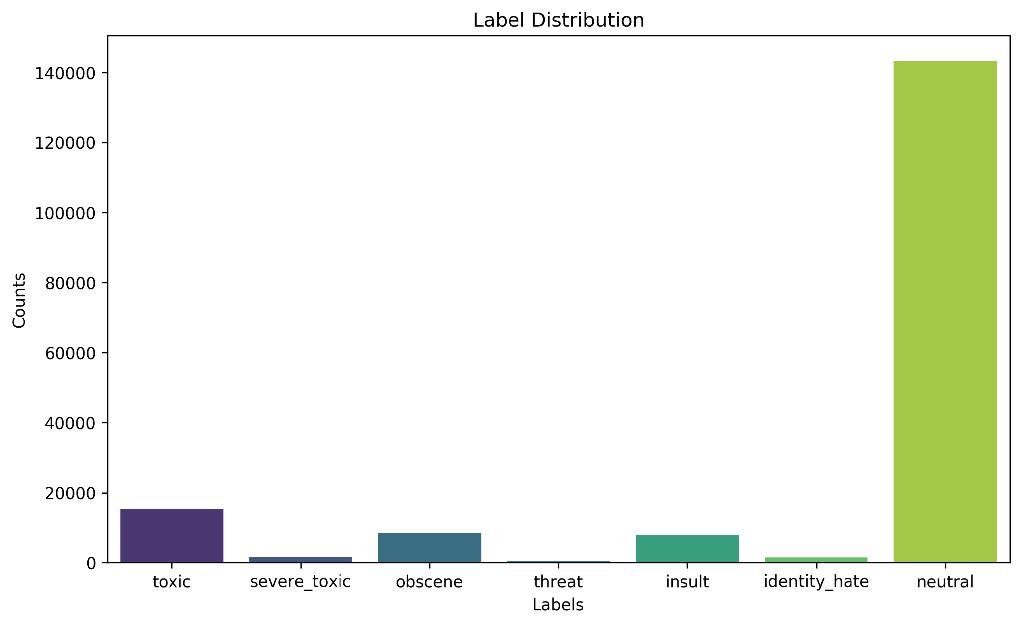
Target Label Distribution

Slide 6
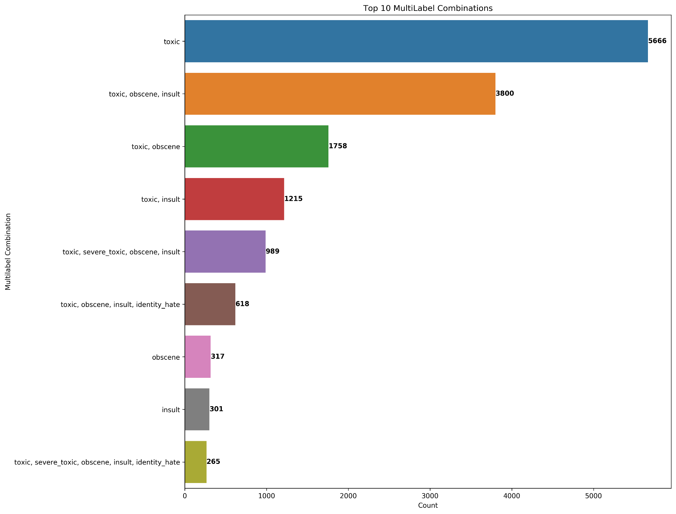
Top 10 Multilabel Combinations

Slide 7
Text Data Lifecycle
Cleaning and Preprocessing
Augmentation
Vectorization
Binary Classification
Multilabel Classification
Text Cleaning
Preprocessing:
Lemmatization
Stopwords
Synonym Replacement to combat class imbalances
Created numeric representations of the text data
Binary Classifier: Toxic vs Neutral
Multi-label Classifier to predict the toxicity subtypes

Slide 8
Data Cleaning:
Removed line breaks
Website links
Email addresses
Html tags
URLs

Slide 9
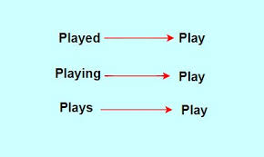
2. Text Preprocessing:
Stopword Removal: Words like ‘is’, ‘the’, ‘and’, etc.
Lemmatization: Reducing words to their base or root form, also known as their ‘lemma’ to simplify text analysis
Notes:
involves reducing words to their base or root form, known as the "lemma."

Slide 10
3. Text Augmentation:
Synonym Replacement
Goal: Increase the representation of the toxic comment samples
How: I used Synonym replacement, involves replacing words in a corpus with one of it’s synonyms.
Tools: WordNet, a large linguistic database from the NLTK library, to identify relevant synonyms and iteratively replace the original text with it’s synonyms
Result: This created additional samples in the toxicity classes that were derived from the original samples

Slide 11
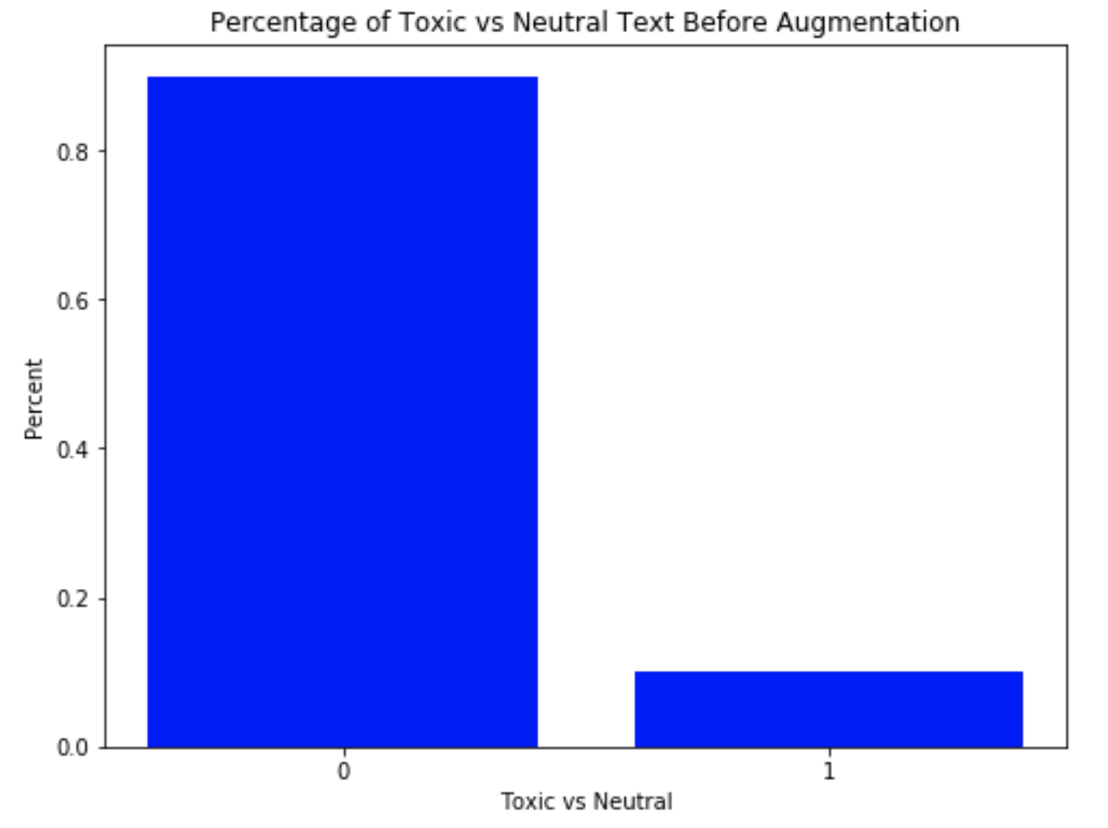
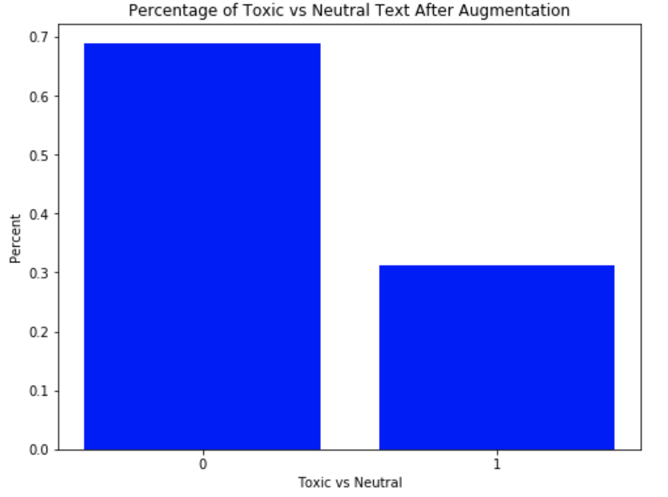
Before and After Text Augmentation

Slide 12
4. Text Vectorization
Text data needs to be converted to numbers so that the machine learning models can understand it.
TFIDF Vectorizer does this by creating numeric representations of words and phrases
This create a feature matrix that helps our model understand which words are important in each type of text.
What words are important in neutral text? What words are important in toxic text?
Notes:
It looks at how often words appear in each piece of text (Term Frequency) and how unique those words are across all the texts (Inverse Document Frequency) to help understand what words are important in each piece of text.

Slide 13
5. Binary Classification Model
The Multinomial Naive Bayes Classifier is a probabilistic model that works well for text classification
The TFIDF Vectorizer and Multinomial Naive Bayes Classifier together in a pipeline to tune hyperparameters using GridsearchCV
Optimized for Recall and ROC AUC Score

Slide 14
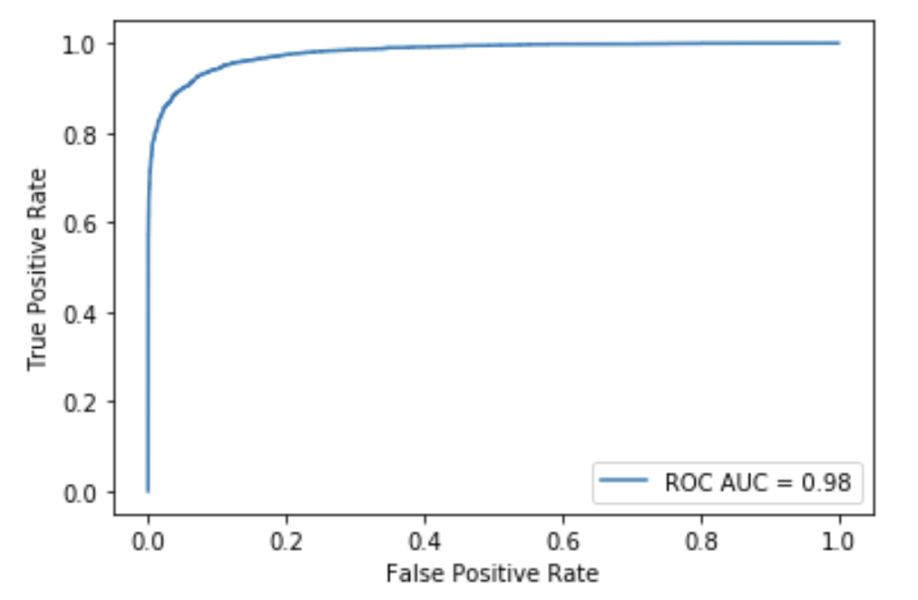
Naive Bayes Classifier Results:
ROC AUC Score: 0.98
Recall: 0.846

Slide 15
6. MultiLabel Classification Model
Used Binary Relevance Model from the Sklearn MultiLearn Module
Classifying Toxicity Subtypes: Toxic, Severe Toxic, Obscene, Threat, Insult, Identity Hate
For each label, a separate classifier (in this case, a Multinomial Naive Bayes Classifier) is trained to predict whether an observation belongs to that label's class or not.
It simplifies the multi label problem into several binary classification problems for each observation.
Used GridsearchCV to tune relevant hyperparameters
Notes:
This approach simplifies the multilabel problem into several binary classification problems, where each classifier focuses on one label independently. It's important to note that this approach doesn't take into account potential dependencies or correlations between different labels.

Slide 16
Multilabel Metrics:
F1 Micro: A combined measure of the model’s accuracy in predicting positive cases across all labels.
Scale of 0.00-1.00 (the higher the better)
Hamming Loss: Quantifies the fraction of labels that are incorrectly predicted across all labels.
Scale of 0.00 - 1.00 (the lower the better)
Notes:
Hamming Loss is a metric used to measure the accuracy of multilabel classification models, particularly in cases where instances can belong to multiple classes simultaneously. It quantifies the fraction of labels that are incorrectly predicted for a given set of instances.

Slide 17
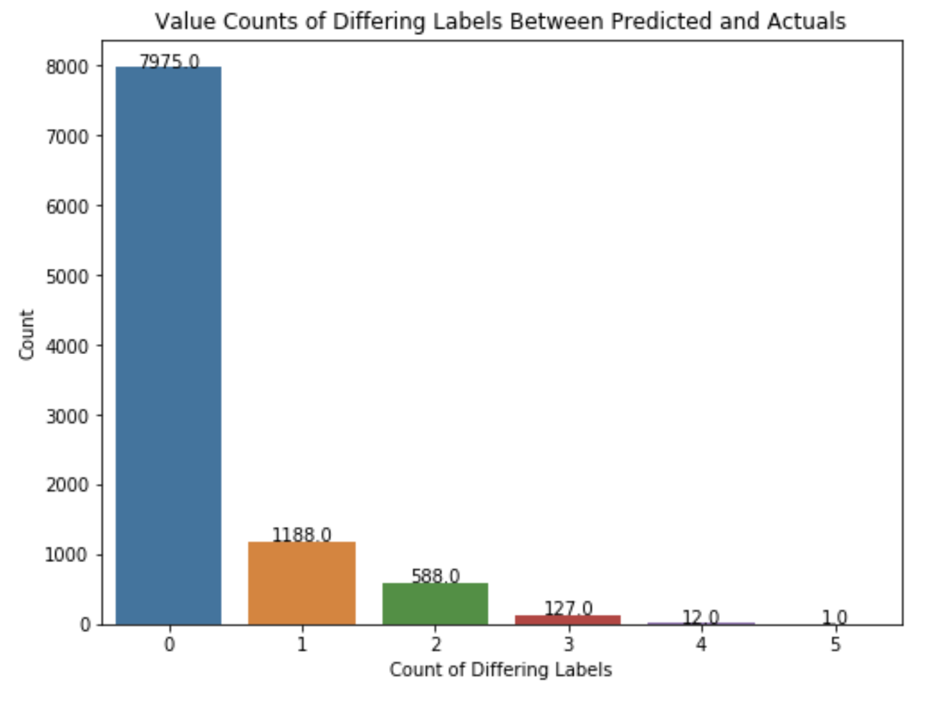
Binary Relevance Results
F1 Micro: 0.79
Hamming Loss: 0.047

Slide 18
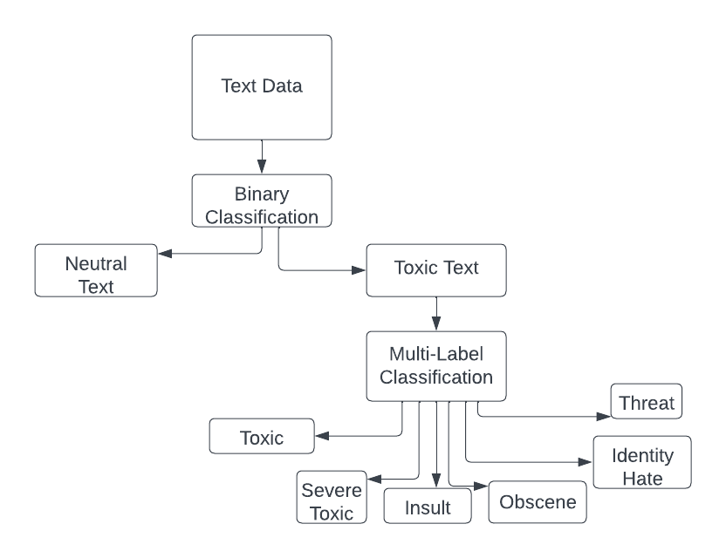
Building a Custom Class
Pickled (saved) individual models in their trained form
Results were consistent with individual model performances:
Binary Recall: 0.867
Hamming Loss: 0.054

Slide 19
Conclusions and Next Steps:
This approach worked well, but there is room for improvement!
Would like to Incorporate more of the features such as sentiment scores, LDA labels, text length, character counts
Identifying toxic text is possible and has been done at a much larger scale!
There are pre-trained large language models that exist to detect hate speech that have been trained on much, much more data.

Slide 20
Thank you!
Robbins_Heather@bah.com
https://github.com/har1113

Slide 21
Resources:
https://www.kaggle.com/datasets/julian3833/jigsaw-toxic-comment-classification-challenge
https://jigsaw.google.com/
https://thedecisionlab.com/insights/health/tdl-brief-online-toxicity
https://www.pewresearch.org/internet/2021/01/13/the-state-of-online-harassment/
https://datareportal.com/

